Slide 1
Tail Latency
by
Jinesh Jayakumar

Slide 2
Basics
What is tail latency
Why is it important
Why does it occur
How to overcome

Slide 3
What is tail latency
Server
T_{M} ± Δ
Client
Typical client server model where T_{M} is median response time

Slide 4
What is tail latency continued..
Cumulative Distribution Function (CDF) of Round Trip Time (RTT) of a
request-response for simple RPC calls within Amazon IaaS cloud

Slide 5
What is tail latency continued (2)..
CDF of RTTs between 99th and 100th percentile

Slide 6
Why is it important
Evolution of Internet – Web 2.0
From static to dynamic content
Warehouse scale computing
Datacenter as computer
Large data sets (Big Data)
Facebook, Google Search, Walmart
Wimpy cores
Request level parallelism
Responsive user interface (feels fluidic)

Slide 7
Why does it occur
Virtualization (scheduling of VMs)
Shared resources (CPU, memory/cache, network)
Background daemons
Global resource sharing (network switches, shared file systems)
Maintenance activities

Slide 8
Why does it occur continued..
Queuing
Power limiting features
Garbage collection
OS Scheduler
Interrupts
NUMA (Non-Uniform Memory Access)

Slide 9
How to overcome
Overprovisioning of resources
Careful real-time engineering of software
Improve reliability and fault-tolerance
Satisfy with good-enough results
Eliminating variability is infeasible
Develop tail tolerant services

Slide 10
Research Papers for Discussion
Tales of Tale (OS, Hardware, Application-level)
Jialin Li, Naveen Sharma, Dan Ports, Steven Gribble
Bobtail (Amazon EC2 Xen Hypervisor)
Yunjing Xu, Zachary Musgrave, Brian Noble, Michael Baley
The Tail at Scale
Jeffrey Dean, Luiz Andre Barroso

Slide 11
Tales of Tail - Setup
High throughput multi-core machine (hyper-threading disabled)
Ubuntu Linux 12.04
24GB RAM (2 x 12GB NUMA nodes)
Null-RPC server (128 bytes of request/response)
Memcached (predictable latency, in-memory hash table)
Nginx web server (event-driven, multiple-worker)

Slide 12
Tales of Tail - Timestamping
Start timestamping when a request is transferred from NIC to kernel
End timestamping when the response is transferred from kernel to NIC
Modified Linux Kernel
Added intermediate timestamp events for diagnostics (not discussed here)

Slide 13
Tales of Tail – Ideal Distribution
Estimate amortized request processing time for single core at 100% utilization
Measure throughput and invert to get estimated latency
Eg, in memcached, at peak 125,000 req/sec the processing time was 8 microseconds
Simulate an M/D/c queue and plot ideal distribution using the sequence of request arrival times measured during experiment (refer paper)

Slide 14
Tales of Tail – Linux Scheduler
Server application need to contend with daemons (sshd, NetworkManager, etc)
Default LINUX scheduler is CFS (Completely Fair Scheduler) gives importance to fairness in allocating CPU to processes
Process niceness of -20 allocates more CPU but other daemons can still preempt our server process.
Realtime scheduler increases process priority strictly higher than other processes.

Slide 15
Tales of Tail – Background Processes

Slide 16
Tales of Tail – FIFO vs non-FIFO

Slide 17
Tales of Tail – Multiple Cores

Slide 18
Tales of Tail – Shared vs Separate Queues

Slide 19
Tales of Tail – Interrupts
Still notice considerable gap between ideal and measured latencies
Analysis identifies kernel interrupt processing as the cause
NIC interrupts host CPU to initiate packet processing
By default interrupt processing is spread over all CPUs (irqbalance daemon)
Server process gets preempted causing it to deviate from ideal model
Assigned dedicated core for processing interrupts

Slide 20
Tales of Tail – Interrupt Processing

Slide 21
Tales of Tail – SMP and NUMA
Tail latency worsens when additional processor (in SMP) is also used
NUMA comes into picture with Multi-processor (not multi-core)
Memcached is most affected since it’s memory intensive
Linux by default allocates memory from single NUMA node for a process until it’s exhausted
Numactl utility can be used to attach a process’ memory allocation to a single NUMA node

Slide 22
Tales of Tail – NUMA Awareness

Slide 23
Tales of Tail – Power Management
C-states and Frequency Scaling are the common power saving features in CPUs
Power Management comes into action under low utilization
Higher C-states require longer wake-up times
Eg. 200 μs to wake up from C3 (highest state)
Scaling governors decide on switching frequencies
Under low frequency, Nginx is most affected since it is most CPU intensive

Slide 24
Tales of Tail – Power Saving

Slide 25
Tales of Tail – Summary
Real-time/FIFO scheduler reduces background process interference
Prefer shared queue over separate queue for each process
Multiple cores reduces latency
Dedicated Interrupt Processing reduces latency
NUMA Awareness on SMP architectures helps
Power Saving Features can adversely affect during low utilization

Slide 26
Bobtail – Overview
Tail latency in Amazon EC2 cloud
Virtualization exacerbates long tail problem by factor of two to four
Latency is a property of nodes rather than network
Root-cause is the co-scheduling of CPU-bound and latency-sensitive VMs (multi-tenancy)
Bobtail algorithm can reduce 99.9th percentile response time by up to 40%

Slide 27
Bobtail – EC2 Experiment
Amazon EC2 – uses Xen hypervisor
Experiment spanned over 5 weeks
Availability Zone (AZ)
One AZ is like a datacenter
Thrift RPC framework instead of raw TCP
Used established TCP connections to avoid TCP handshake overheads
Focus on tail of round-trip latency since it impacts user experience

Slide 28
Bobtail – EC2 Experiment
Tail latency between 99th and 100th percentile

Slide 29
Bobtail – Analysis – RTT Heatmap
Heat map of the 99.9th percentile of RTTs, shown for 16 small pairwise instances in
milliseconds. Long tail problem is a property of specific nodes instead of the network.

Slide 30
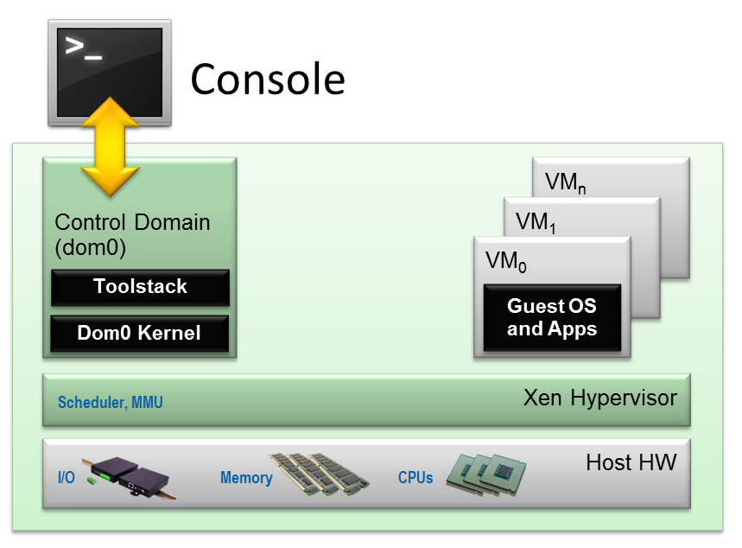
Bobtail – Analysis - Xen Architecture
Courtesy: wiki.xenproject.org

Slide 31
Bobtail – Xen Hypervisor Properties
VM scheduler is credit-based
30ms credit for each VCPU
Decremented in 10ms interval
Lightly-loaded VCPU enters BOOST state
Can preempt other VCPUS upon I/O interrupt but with 10ms granularity
VCPUs in BOOST state run in FIFO order
BOOST state still not effective for latency-sensitive VCPUs

Slide 32
Bobtail – Controlled Experiment

Slide 33
Bobtail – Controlled Experiment 2

Slide 34
Bobtail – Experiment Conclusion
Co-locating CPU-intensive and latency-sensitive VMs increases tail latency
Instantiating CPU-intensive VMs more than available physical CPU cores affect tail latency
BOOST mechanism is effective only if all CPU-intensive VCPUs use almost 100% CPU

Slide 35
Bobtail – Algorithm

Slide 36
Bobtail – Algorithm Parameterization
Setting M to 600K enough to decide on a node in about 100 seconds
LOW_MARK around 13 to achieve < 0.1 false positive rate
HIGH_MARK set about five times LOW_MARK reduces false negative rate < 0.1
To instantiate N good nodes, we need to test K*N instances. K ≈ 3.6 seem to be good enough for EC2

Slide 37
Bobtail – Results

Slide 38
Bobtail – Summary
When Bobtail is used extensively in EC2 partitions of co-located CPU-intensive and latency-sensitive emerge.
Co-locating similar workloads benefits both
Refer paper for benchmarks with different types of traffic models
Alternative solutions involve overhaul of VM placement policy to avoid over-subscribing physical CPUs and co-location of different types of VM

Slide 39
Tail at Scale – Hedged Requests
Same request to multiple replicas
Request sent to secondary only after a delay
Secondary request should accompany a cancellation request for the first request
Eg. Defer sending secondary request until 95th percentile latency of first request.
Additional load is only 5%
Substantially reduces latency tail
Overhead reduced further by tagging hedged requests as low priority

Slide 40
Tail at Scale – Tied Requests
Hedged request has a window of vulnerability
Multiple servers can execute same request unnecessarily
Instead queue copies tied requests simultaneously
Communicate status with each other
Cancel other requests when one request begins execution
Brief delay (eg. 1ms) between requests preferred to reduce chances of cancelling out each other

Slide 41
Tail at Scale – Large Information Retrieval Systems
Good Enough – user may be best served by being given slightly incomplete “good enough” results for better latency
Eg. Google results from ads, spelling corrections, etc
Canary Requests – exercises caution where untested code paths can cause crashes or extremely long delays
Sends one or two requests first and if they do not succeed within reasonable amount of time, the request is marked as dangerous and prevented from execution.

Slide 42
Tail at Scale – Large Information Retrieval Systems
Canary Requests also help prevent denial-of-service attacks
Despite slight increase in latency, canary requests are used for every request in Google’s large fan-out search systems due to additional safety they provide
These are tail-tolerant techniques since the tail latency can never be fully eliminated
Techniques can be encapsulated within baseline libraries and systems with radically simpler application-level designs

Slide 43
Thank You

